Slide 1
QSR algorithm
QC40: Physics of Computation Conference 40th Anniversary
arXiv:2012.02338
Pedro Rivero — May 6, 2021

Slide 2
Contents
Summary
Intro to VQE and motivation
Quantum Sampling Regression (QSR)
Algorithmic complexity in the low quit number regime
Applications
Benchmark
Conclusions

Slide 3
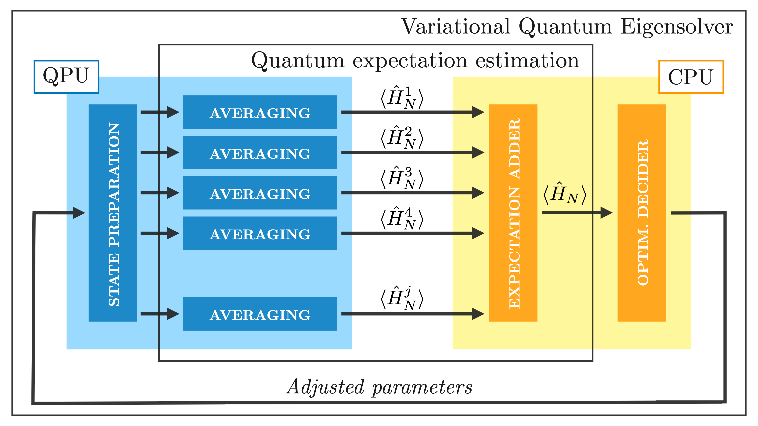
VQE algorithm
Hybrid quantum-classical variational eigensolving
Quantum processor embedded within a classical optimization loop.
On each cycle the QPU gets called several times by the classical optimizer.

Slide 4
VQE algorithm
Hybrid quantum-classical variational eigensolving
Quantum processor embedded within a classical optimization loop.
On each cycle the QPU gets called several times by the classical optimizer.
Bottleneck: establishing an HTTP connection to update the parameters in the quantum circuit.

Slide 5
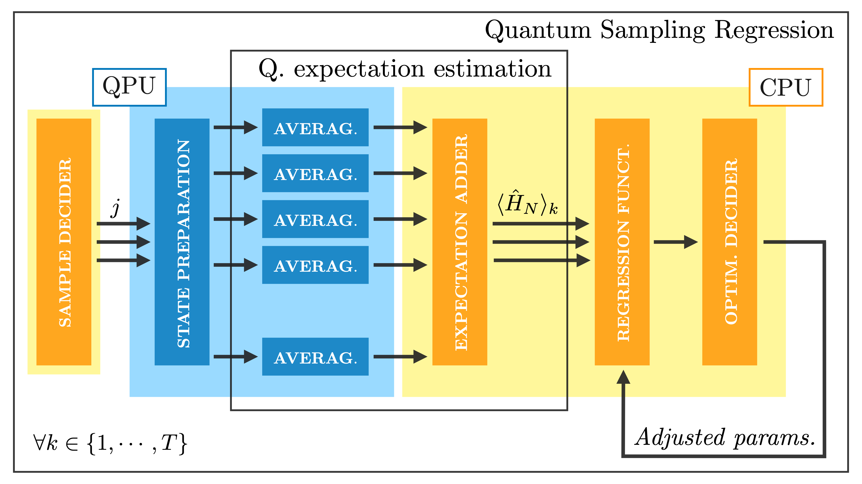
QSR algorithm
Hybrid quantum-classical variational eigensolving

Slide 6
QSR algorithm
Hybrid quantum-classical variational eigensolving
All calls to the QPU are performed together at the beginning.

Slide 7
QSR algorithm
Hybrid quantum-classical variational eigensolving
All calls to the QPU are performed together at the beginning.
Target function is reconstructed classically as a trigonometric series.

Slide 8
QSR algorithm
Hybrid quantum-classical variational eigensolving
All calls to the QPU are performed together at the beginning.
Target function is reconstructed classically as a trigonometric series.
Optimization loop runs isolated in the CPU → Better convergence.

Slide 9
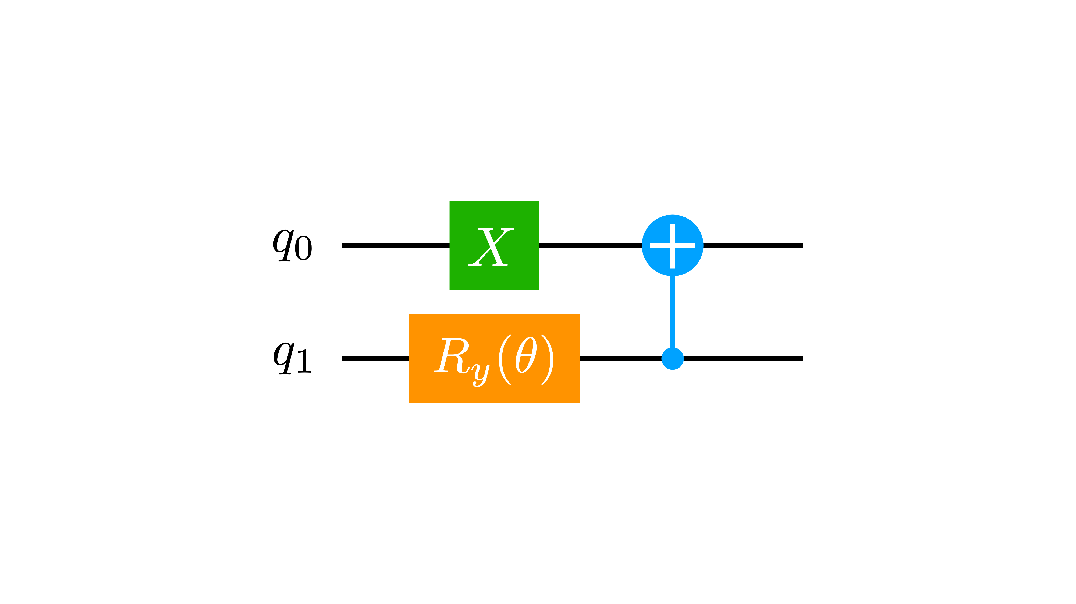
QSR algorithm
Motivation
PARAMETRIZATION
ANSATZES
Rotations

Slide 10
QSR algorithm
Motivation
PARAMETRIZATION
ANSATZES
Rotations
BOUNDED AND PERIODIC DOMAIN
Trigonometric series expansion

Slide 11
QSR algorithm
Motivation
PARAMETRIZATION
ANSATZES
Rotations
BOUNDED AND PERIODIC DOMAIN
Trigonometric series expansion
QUANTUM CIRCUIT TOPOLOGY
Frequency bounds

Slide 12
QSR algorithm
Motivation
Fourier analysis
PARAMETRIZATION
ANSATZES
Rotations
BOUNDED AND PERIODIC DOMAIN
Trigonometric series expansion
QUANTUM CIRCUIT TOPOLOGY
Frequency bounds

Slide 13
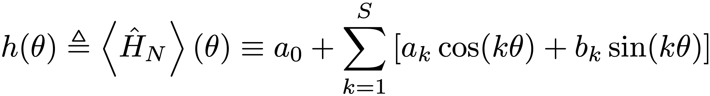
QSR algorithm
How it works
Reconstruct the energy landscape classically → Trigonometric series (1D)

Slide 14
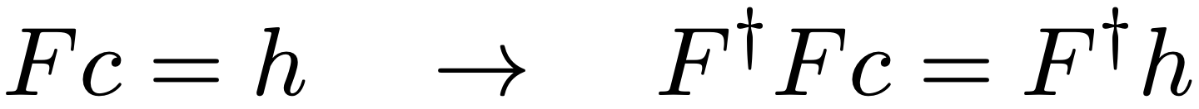
QSR algorithm
How it works
Reconstruct the energy landscape classically → Trigonometric series (1D)
To find the coefficients we have to solve a linear system of the form:

Slide 15
QSR algorithm
How it works
Reconstruct the energy landscape classically → Trigonometric series (1D)
To find the coefficients we have to solve a linear system of the form:
least squares

Slide 16
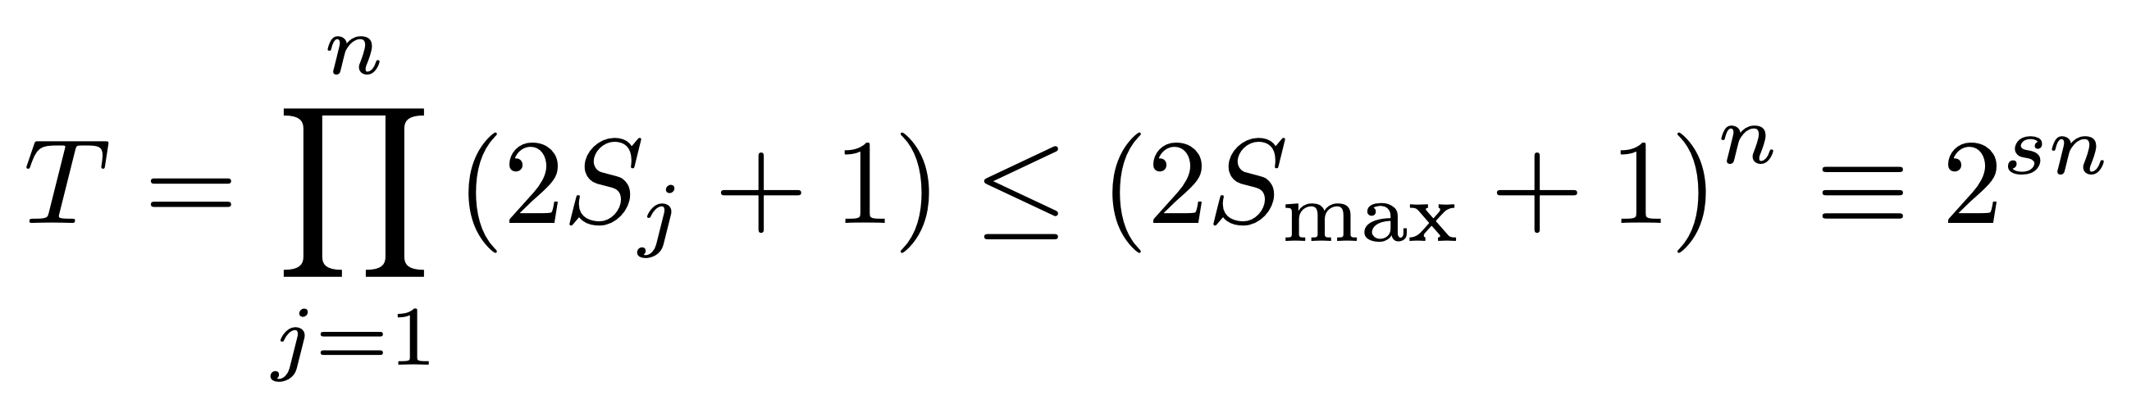
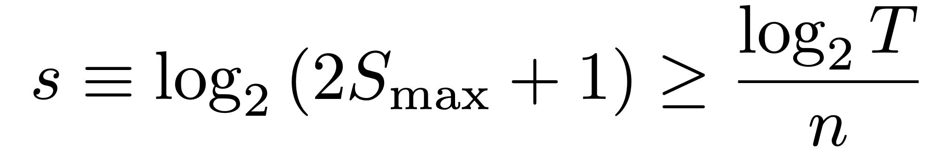
QSR algorithm
How it works
Reconstruct the energy landscape classically → Trigonometric series (1D)
To find the coefficients we have to solve a linear system of the form:
Total number of samples needed is:
least squares

Slide 17
QSR algorithm
Optimality
NYQUIST-SHANNON SAMPLING THEOREM
If a function h(θ) contains no angular frequencies higher than ω, it is completely determined by giving its ordinates at a series of points 1/2ωS apart: ωsampling > 2ωS

Slide 18
QSR algorithm
Optimality
NYQUIST-SHANNON SAMPLING THEOREM
If a function h(θ) contains no angular frequencies higher than ω, it is completely determined by giving its ordinates at a series of points 1/2ωS apart: ωsampling > 2ωS
SIGNAL PROCESSING
Using techniques such as compressed sensing we could improve upon this.

Slide 19
QSR algorithm
Optimality
NYQUIST-SHANNON SAMPLING THEOREM
If a function h(θ) contains no angular frequencies higher than ω, it is completely determined by giving its ordinates at a series of points 1/2ωS apart: ωsampling > 2ωS
SIGNAL PROCESSING
Using techniques such as compressed sensing we could improve upon this.
ERROR MITIGATION
Increase the total amount of samples, or optimize the spacing between them (i.e. the lattice)

Slide 20
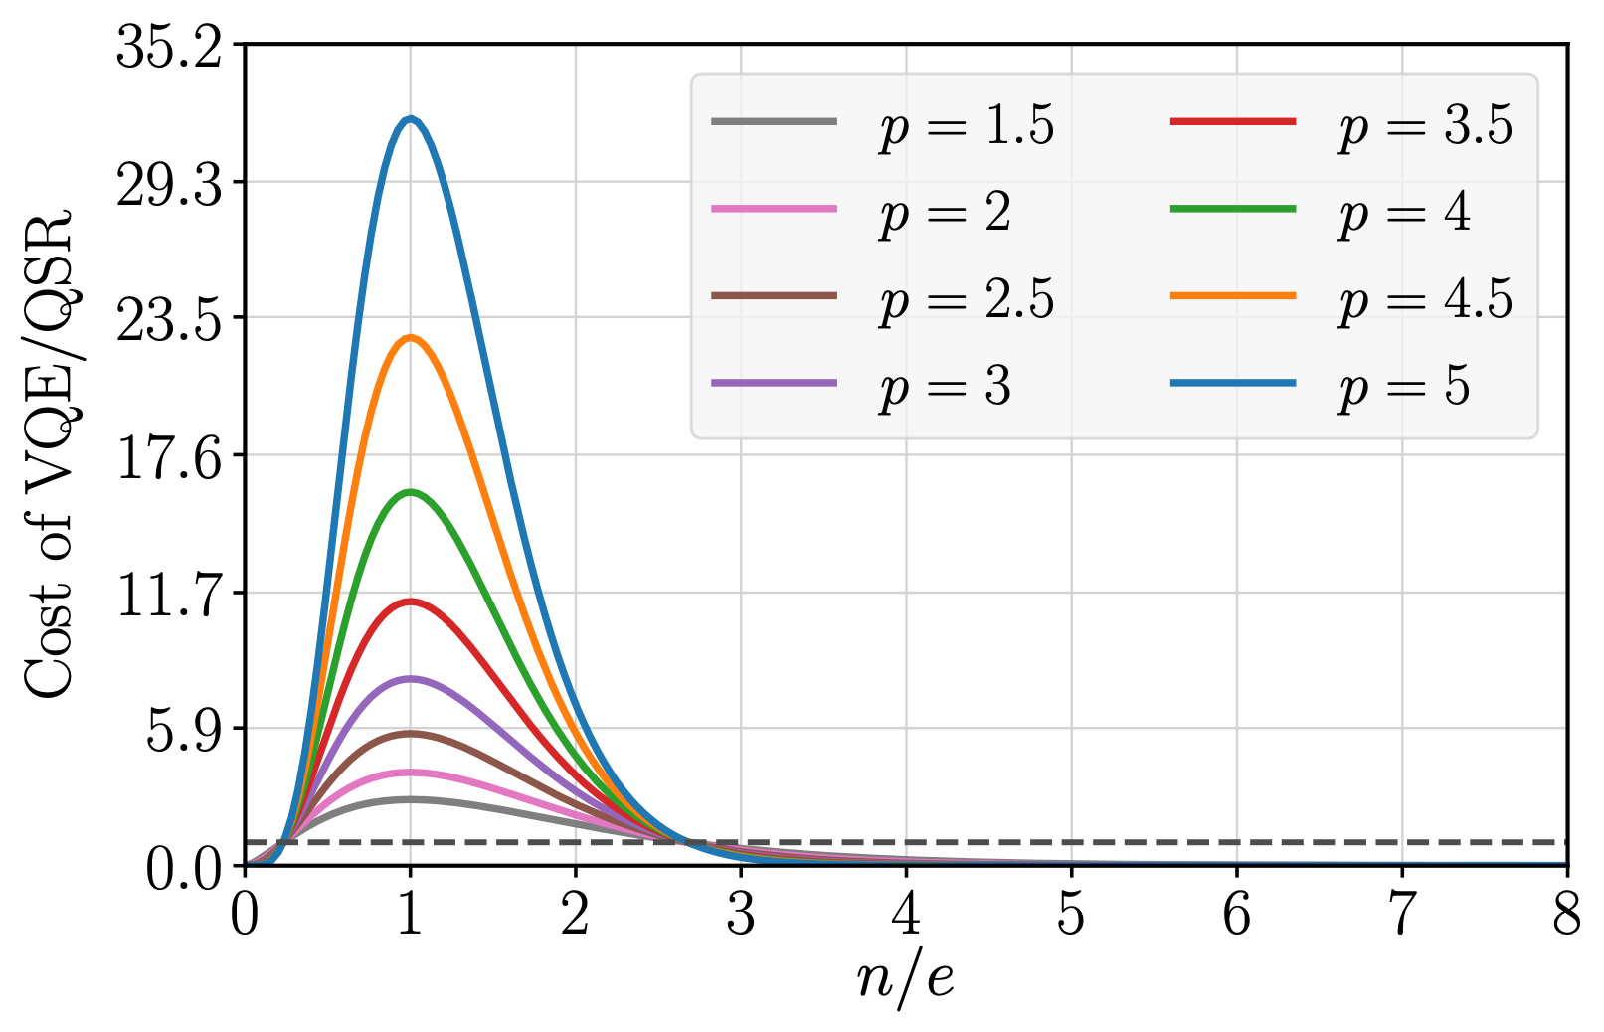
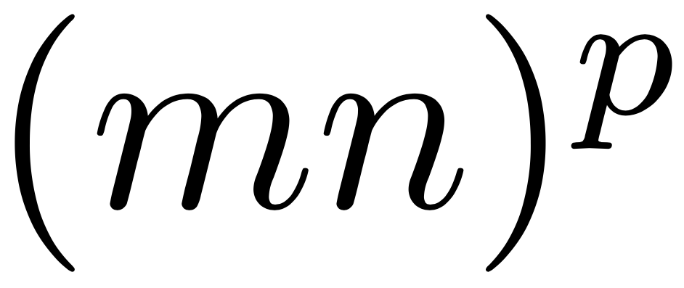
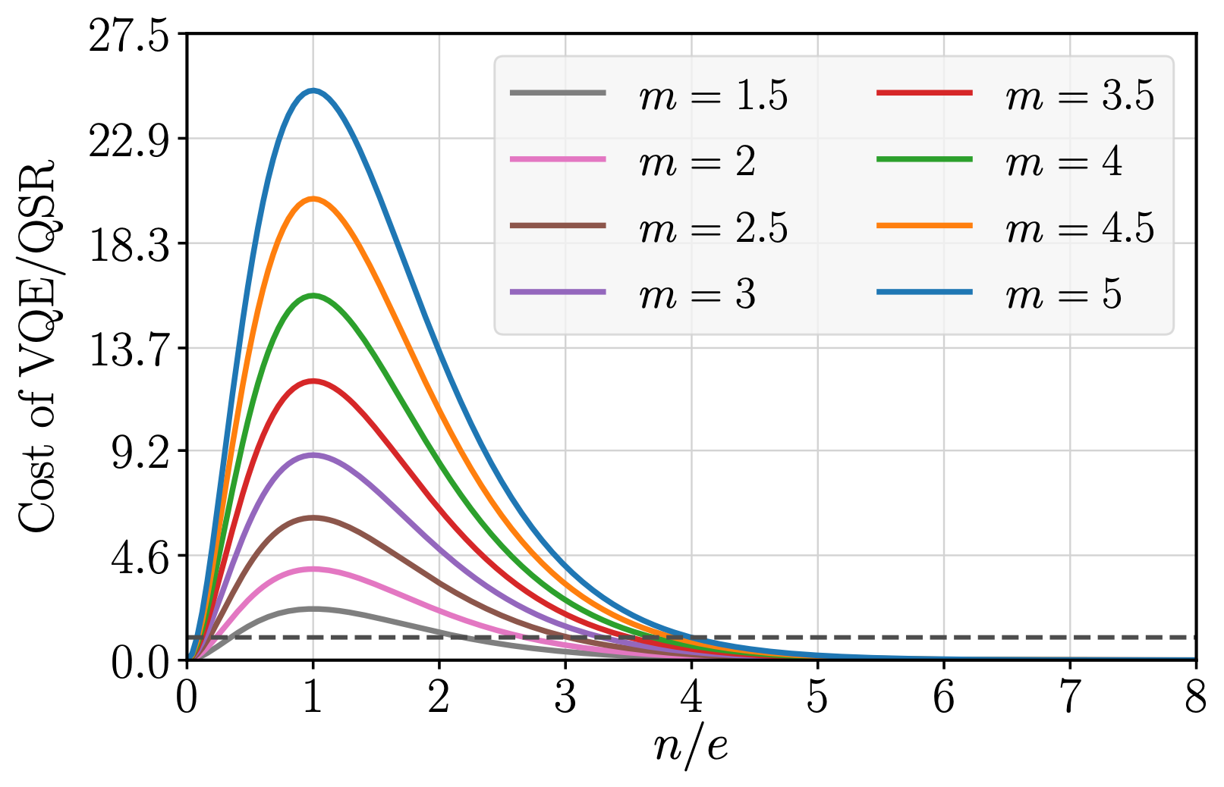
Algorithmic complexity
Low quit number regime model
Monomial complexity lower bound for VQE →
Samples required by QSR →

Slide 21
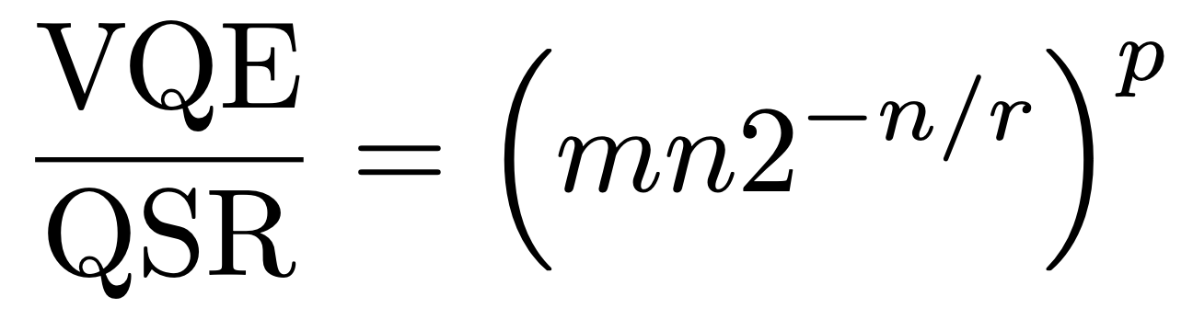
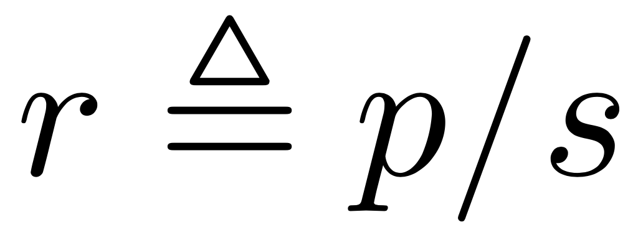
Algorithmic complexity
Low quit number regime model
Monomial complexity lower bound for VQE →
Samples required by QSR →
Resulting complexity model:

Slide 22
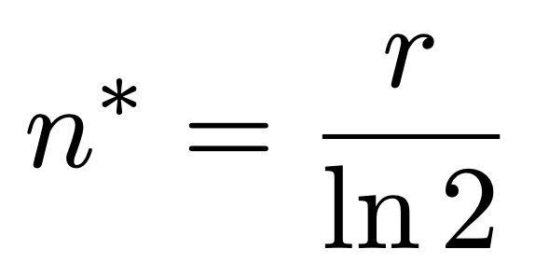
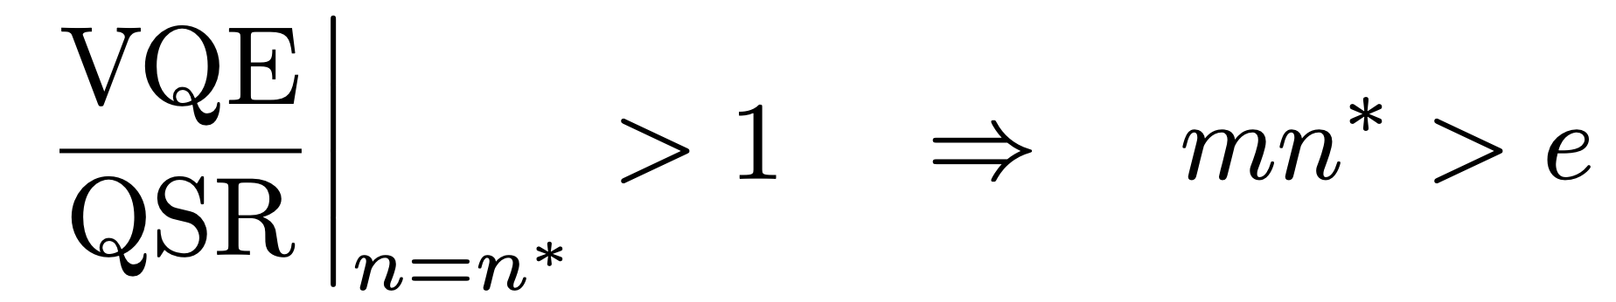
Algorithmic complexity
Low quit number regime model
Cost ratio distribution peak:
Condition to outperform VQE:

Slide 23
Algorithmic complexity
Low quit number regime model
Cost ratio distribution peak:
Condition to outperform VQE:
threshold

Slide 24
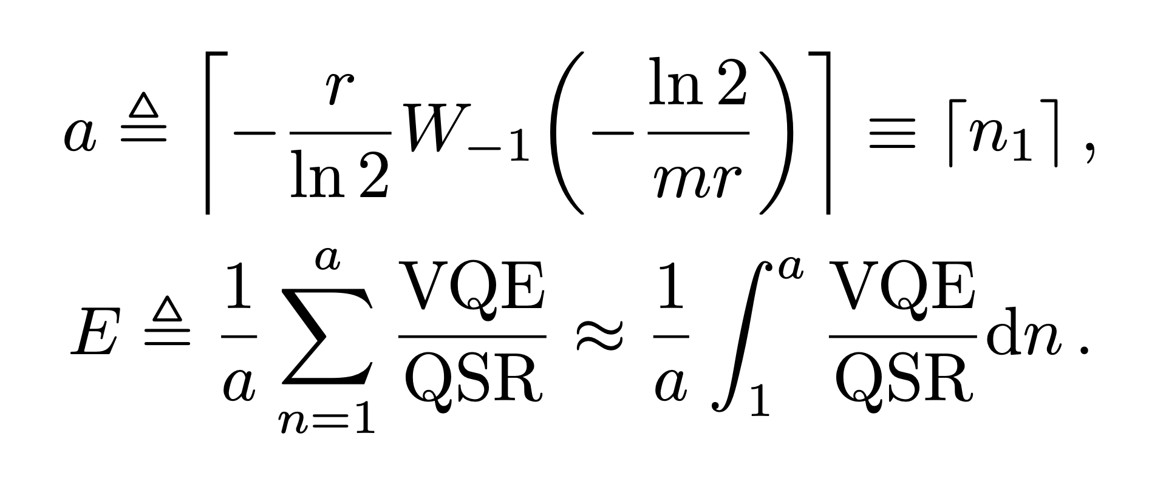
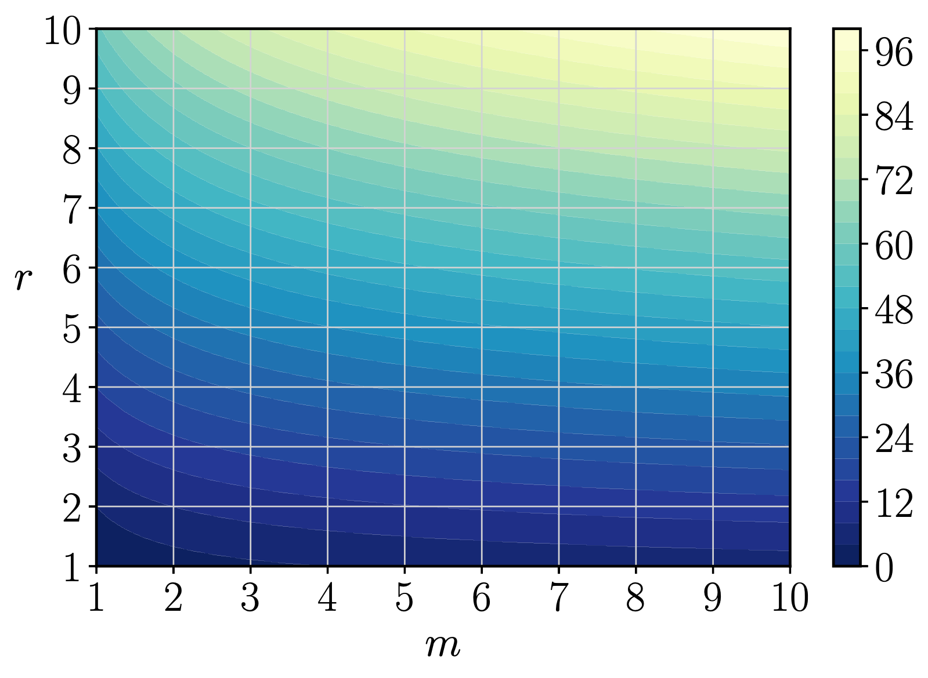
Algorithmic complexity
Analytical results
Threshold

Slide 25
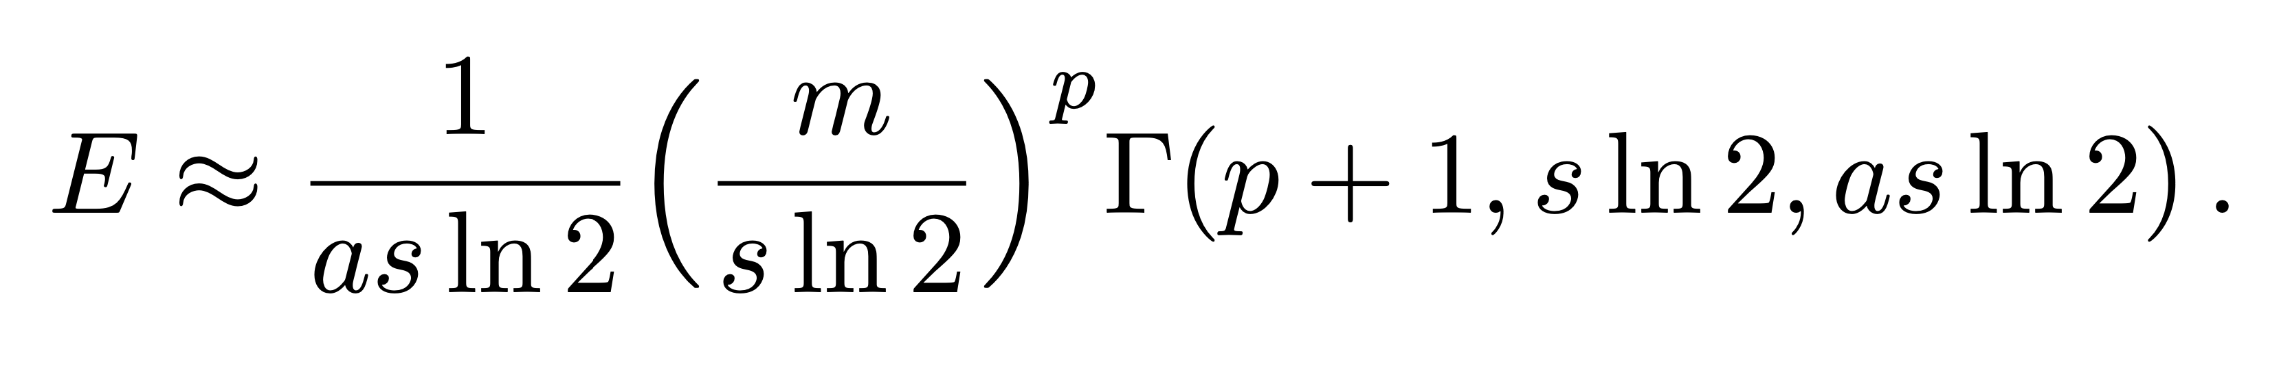
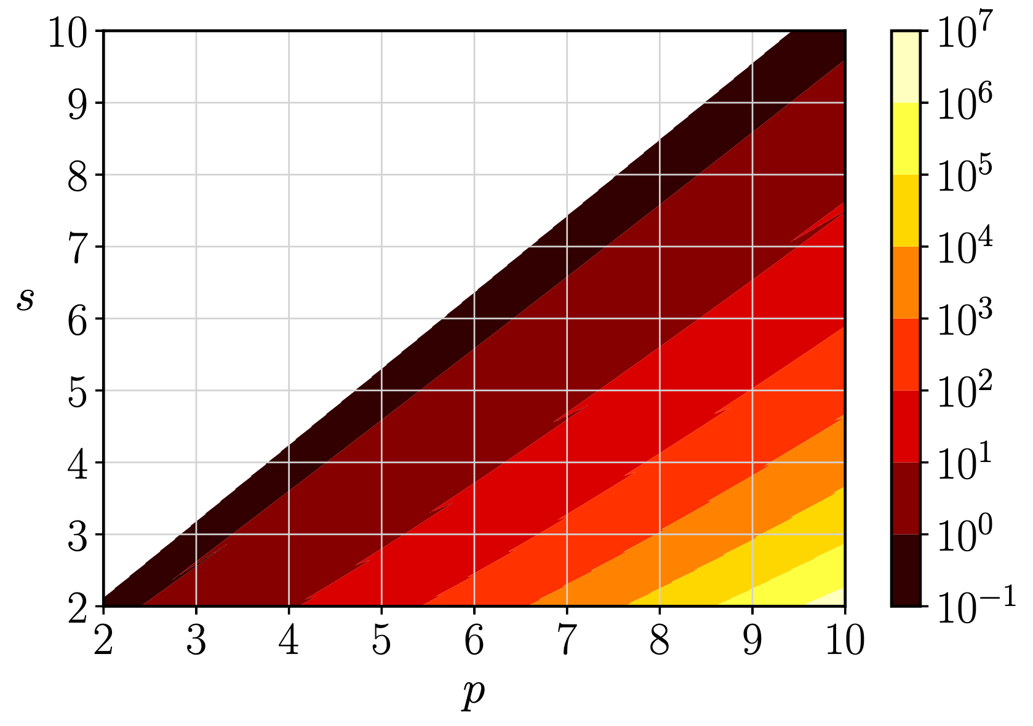
Algorithmic complexity
Analytical results
Threshold
Efficiency

Slide 26
Algorithmic complexity
Analytical results
exponential
Threshold
Efficiency

Slide 27
Algorithmic complexity
Scale picture
SIMULATION PROBLEMS
{n~50, s~3} → p ≥ 14

Slide 28
Algorithmic complexity
Scale picture
SIMULATION PROBLEMS
{n~50, s~3} → p ≥ 14
OPTIMIZATION PROBLEMS
{n~10, s~6} → p ≥ 11

Slide 29
Algorithmic complexity
Scale picture
SIMULATION PROBLEMS
{n~50, s~3} → p ≥ 14
OPTIMIZATION PROBLEMS
{n~10, s~6} → p ≥ 11
NON-FRONTIER PROBLEMS
{n ≤ 15, s ≤ 4} → p ≥ 7±3

Slide 30
Algorithmic complexity
Scale picture
SO FAR...
SIMULATION PROBLEMS
{n~50, s~3} → p ≥ 14
OPTIMIZATION PROBLEMS
{n~10, s~6} → p ≥ 11
NON-FRONTIER PROBLEMS
{n ≤ 15, s ≤ 4} → p ≥ 7±3

Slide 31
Applications
Standalone uses
Increase precision
Adjust the spacing in the lattice
Oversample

Slide 32
Applications
Standalone uses
Increase precision
Adjust the spacing in the lattice
Oversample
Undersampling
Boost performance
Get rid of local minima
Signal processing techniques → Retain precision

Slide 33
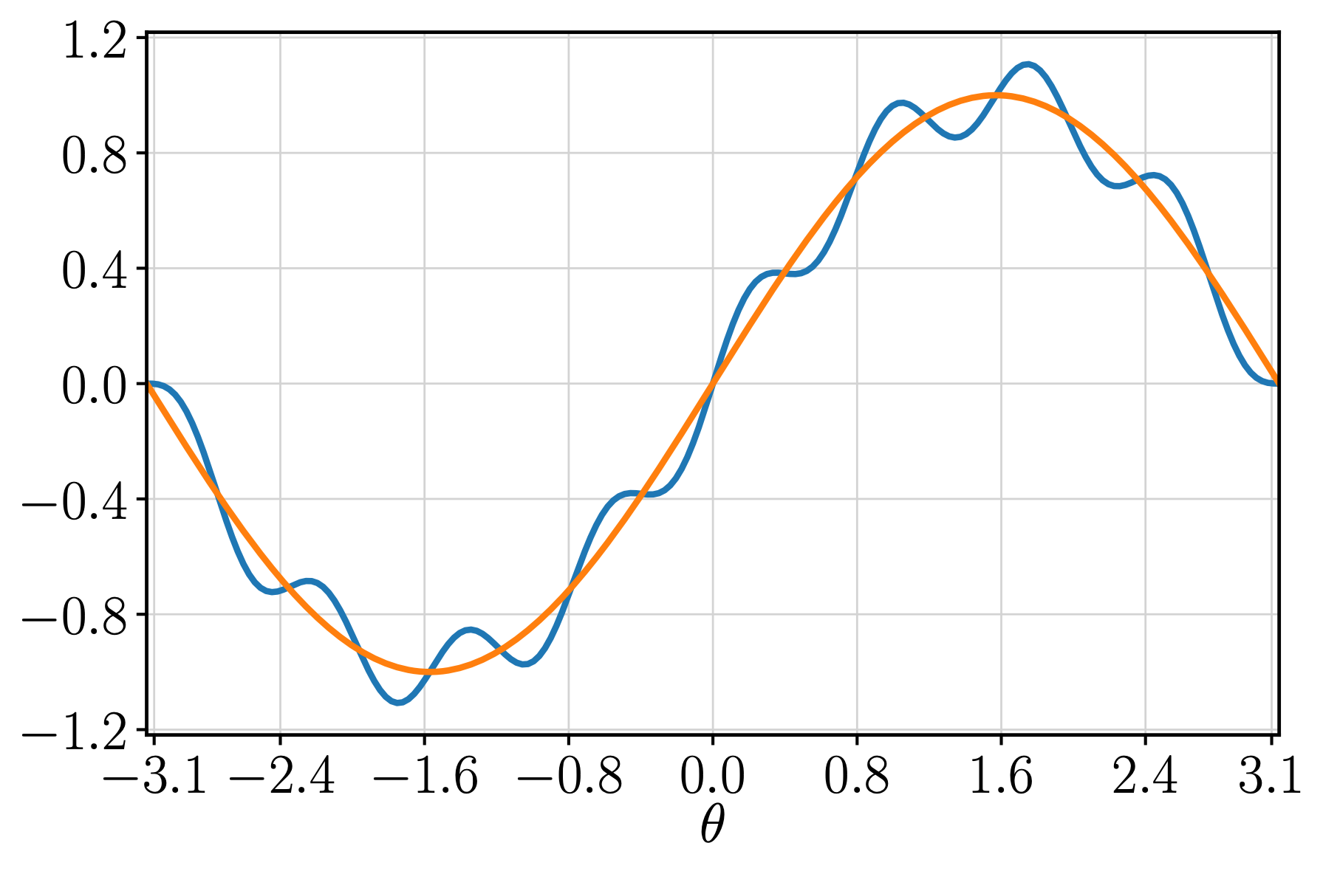
Applications
Standalone uses
Increase precision
Adjust the spacing in the lattice
Oversample
Undersampling
Boost performance
Get rid of local minima
Signal processing techniques → Retain precision

Slide 34
Applications
Complementary uses
Low-resolution start-up supplement to VQE or variants:
Run QSR undersampling to obtain an approximate solution
Use said approximation as a better initial state for VQE → Alternative to Hartree-Fock

Slide 35
Applications
Complementary uses
Low-resolution start-up supplement to VQE or variants:
Run QSR undersampling to obtain an approximate solution
Use said approximation as a better initial state for VQE → Alternative to Hartree-Fock
Proxy to transition between simulators and real devices:
Improve convergence by removing the stochastic behavior
Retain characteristic quantum computational features → Analyze global properties

Slide 36
Applications
Complementary uses
Low-resolution start-up supplement to VQE or variants:
Run QSR undersampling to obtain an approximate solution
Use said approximation as a better initial state for VQE → Alternative to Hartree-Fock
Proxy to transition between simulators and real devices:
Improve convergence by removing the stochastic behavior
Retain characteristic quantum computational features → Analyze global properties
Avoid the exponential matrix formulation in classical computation.

Slide 37
Benchmark
Deuteron binding energy
arXiv:1801.03897
Sθ = 1
Smax = 1

Slide 38
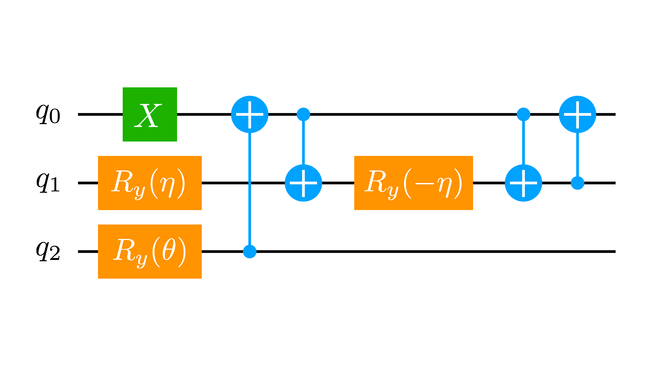
Benchmark
Deuteron binding energy
arXiv:1801.03897
Sθ = 1
Smax = 1

Slide 39
Benchmark
Deuteron binding energy
arXiv:1801.03897
Sθ = 1
Smax = 1

Slide 40
Benchmark
Deuteron binding energy
arXiv:1801.03897
FREQUENCY DOUBLING
Sθ = 1
Smax = 1
Sθ = 1
Sη = 2
Smax = 2

Slide 41
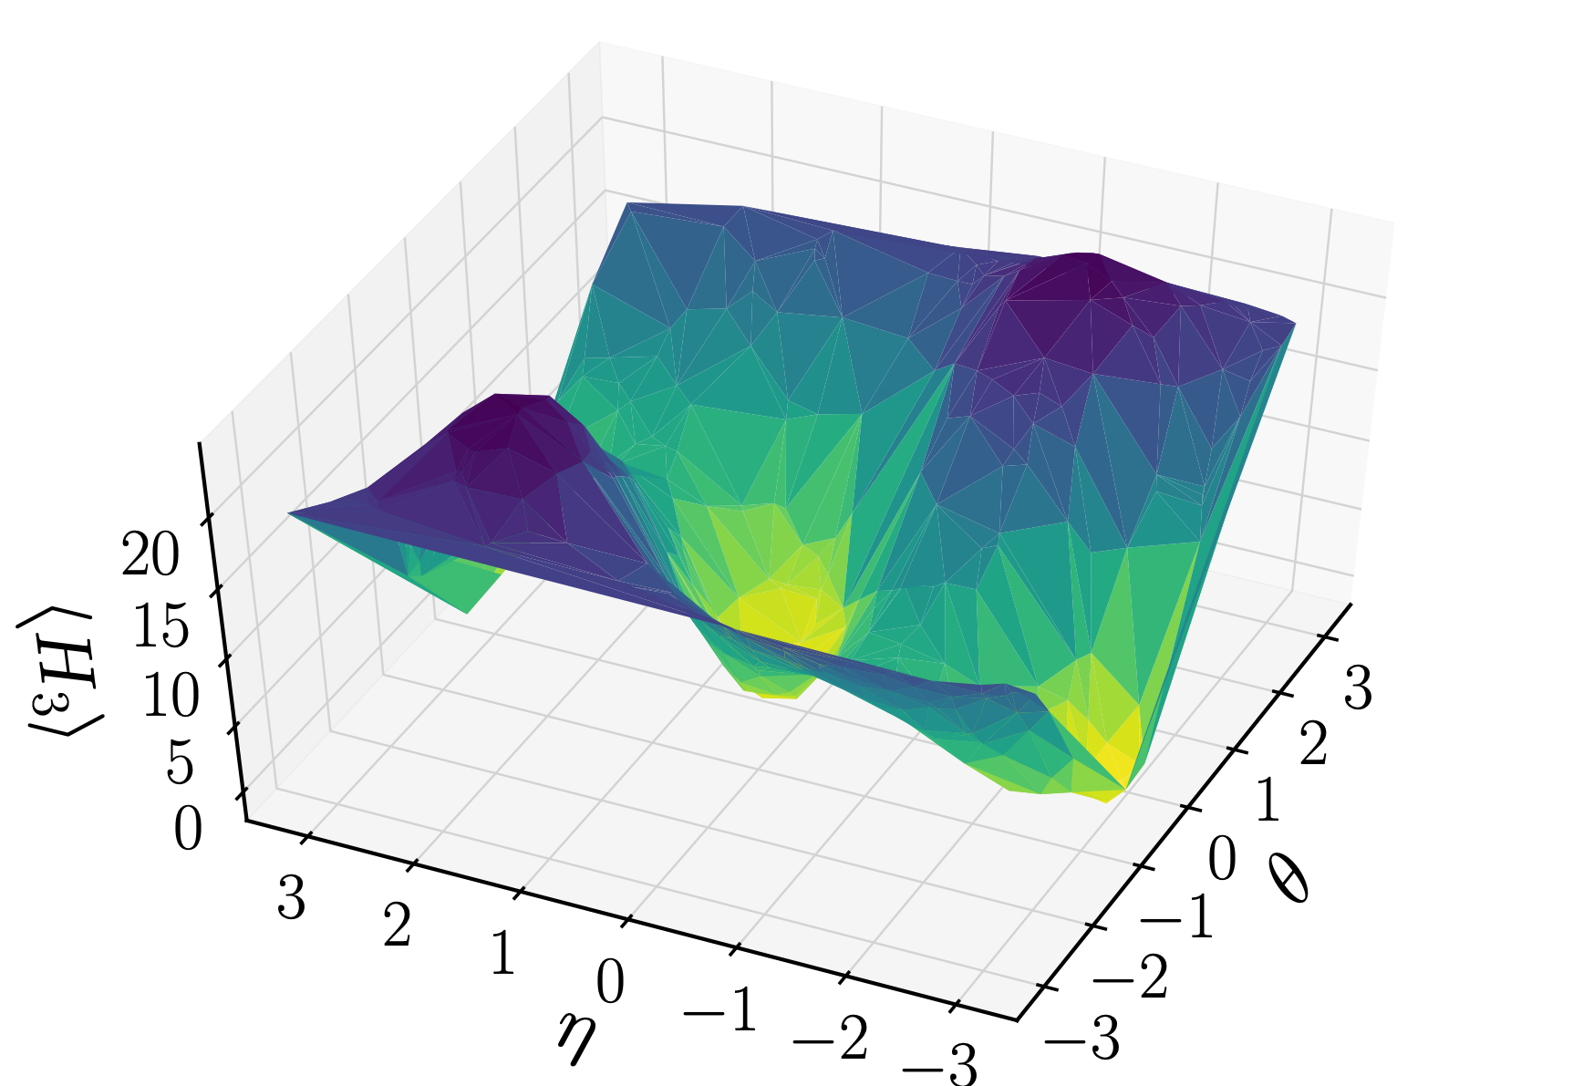
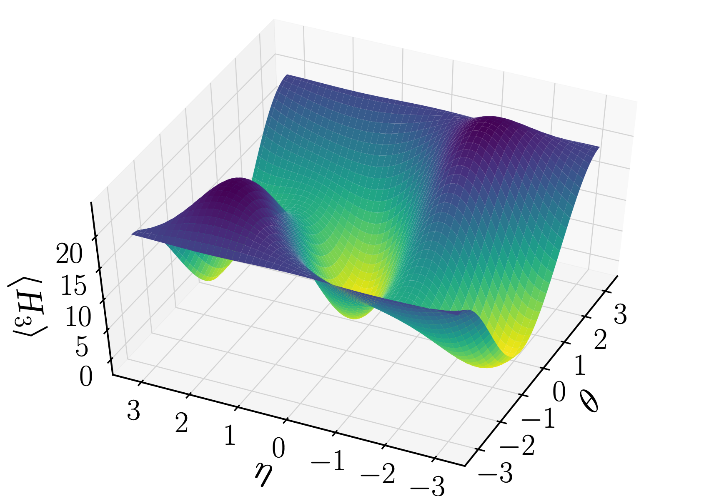
Benchmark
Deuteron binding energy
arXiv:1801.03897

Slide 42
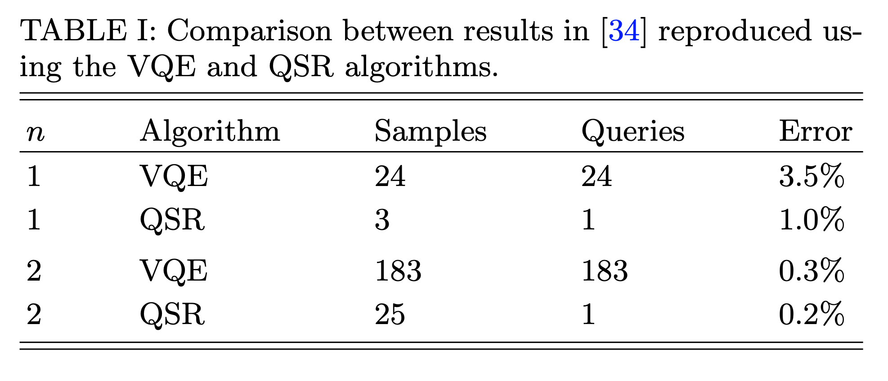
Benchmark
Deuteron binding energy
arXiv:1801.03897

Slide 43
Benchmark
Deuteron binding energy
arXiv:1801.03897
ibmq ourense
8192 shots

Slide 44
Conclusions
QSR algorithm
QSR is a global approximation technique that gets rid of connection bottlenecks:
For complex enough optimization problems, there is a region in the low quit number regime, where QSR outperforms VQE.
QSR knows all the samples needed in advance.

Slide 45
Conclusions
QSR algorithm
QSR is a global approximation technique that gets rid of connection bottlenecks:
For complex enough optimization problems, there is a region in the low quit number regime, where QSR outperforms VQE.
QSR knows all the samples needed in advance.
QSR behaves well with a larger range of optimizers:
It gets rid of the local stochastic behavior of the target function.

Slide 46
Conclusions
QSR algorithm
QSR is a global approximation technique that gets rid of connection bottlenecks:
For complex enough optimization problems, there is a region in the low quit number regime, where QSR outperforms VQE.
QSR knows all the samples needed in advance.
QSR behaves well with a larger range of optimizers:
It gets rid of the local stochastic behavior of the target function.
QSR enables signal processing techn. to solve optimization problems more efficiently.

Slide 47
Conclusions
QSR algorithm
QSR is a global approximation technique that gets rid of connection bottlenecks:
For complex enough optimization problems, there is a region in the low quit number regime, where QSR outperforms VQE.
QSR knows all the samples needed in advance.
QSR behaves well with a larger range of optimizers:
It gets rid of the local stochastic behavior of the target function.
QSR enables signal processing techn. to solve optimization problems more efficiently.
QSR can be used in conjunction with other algorithms such as VQE.

Slide 48



Thanks
arXiv:2012.02338
priveroramirez@anl.gov
Pedro Rivero

